Slide 1

Cross Browser Testing & Mobile Testing

Slide 2
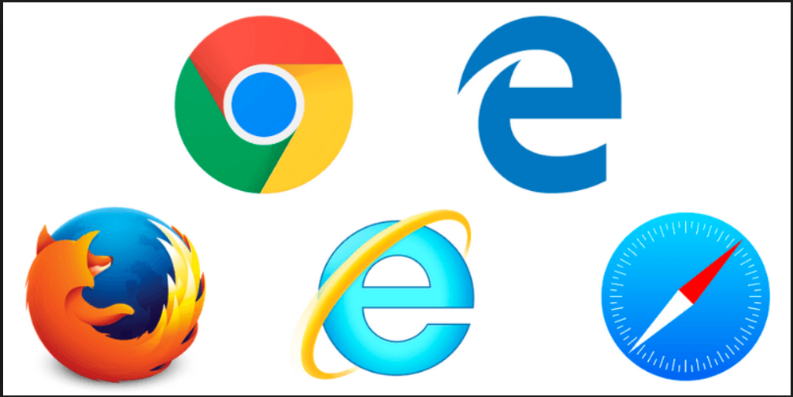
Cross Browser Testing
Cross Browser Testing is a process to test the Web applications across multiple browsers.
Cross browser testing involves checking compatibility of your application across multiple web browsers and that your web application works correctly across different web browsers.

Slide 3

Why Cross Browser Testing is Important?
With such a wide range of browsers, devices, and operating systems available today, cross browser testing is a crucial part of developing software.
The purpose of cross-browser testing is to provide a consistent behavior and experience across all browsers, devices, and platforms.

Slide 4
Why Testing Different Browsers?
Browsers may have bugs
Difference in feature implementations
Different levels of new feature implementation
Devices constraints like hardware capabilities and display size

Slide 5
Month-by-Month Browser Statistics
2019 | Chrome | Edge/IE | Firefox | Safari | Opera
May | 80.4 % | 3.6 % | 9.5 % | 3.3 % | 1.7 %
April | 80.3 % | 3.6 % | 9.6 % | 3.3 % | 1.7 %
March | 80.0 % | 3.8 % | 9.6 % | 3.3 % | 1.7 %
February | 79.7 % | 4.0 % | 10.0 % | 3.4 % | 1.6 %
January | 79.5 % | 4.0 % | 10.2 % | 3.3 % | 1.6 %
https://www.w3schools.com/browsers/

Slide 6

Cross Browser Testing – What to test?
CSS validation (Cascading Style Sheet)
HTML or XHTML validation
Page validations with and without JavaScript enabled
Ajax and JQeury functionality
Font size validation
Page layout in different resolutions
All images and alignment
Header and footer sections
Page content alignment to center, LHS or RHS
Page styles
Date formats
Special characters with HTML character encoding
Page zoom-in and zoom-out functionality
Repeat the testing:
Different Operating Systems like Windows, Linux, and Mac
Different browsers (with different versions) like Internet Explorer, Firefox, Google Chrome, Safari, and Opera.

Slide 7
Cross Browser Testing Tools
Saucelabs
Browserstack Live
BrowserShots
EndTest
Selenium Grid

Slide 8
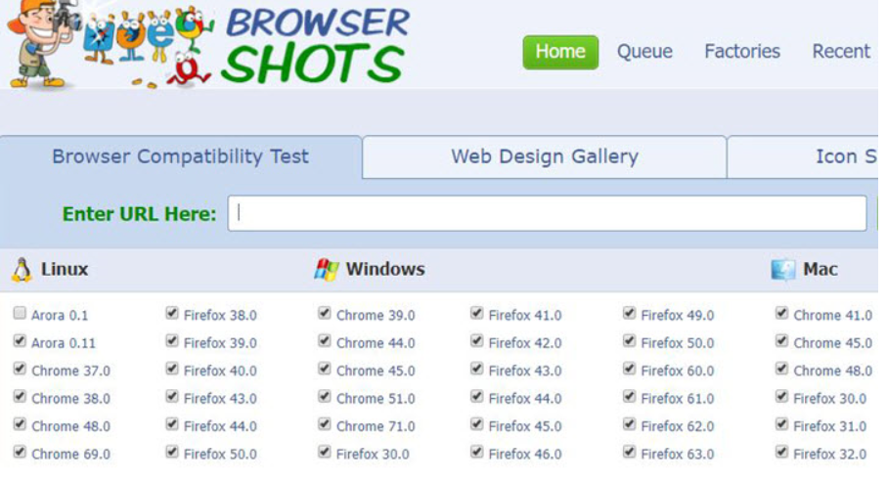

Slide 9

More on BrowserShots
Run cross-browser compatibility tests with great customization options like
Browser type
Operating system
Screen size
Color depth
JavaScript status
Flash enable/disable settings
Enter: website URL, compatibility test parameters and Submit the test request.
This free browser compatibility test service can be used for taking website screen-shots almost in 61 browsers and various operating systems.

Slide 10
References
https://developer.mozilla.org/en-US/docs/Learn/Tools_and_testing/Cross_browser_testing
https://www.w3.org/WAI/intro/people-use-web/browsing
https://www.w3schools.com/browsers/
https://notes.mobiterra.com/react-native-part-1-the-problems-1ba30ff49ad7#.4svwvukmy
https://www.tutorialspoint.com/mobile_testing/mobile_testing_tutorial.pdf

Slide 11
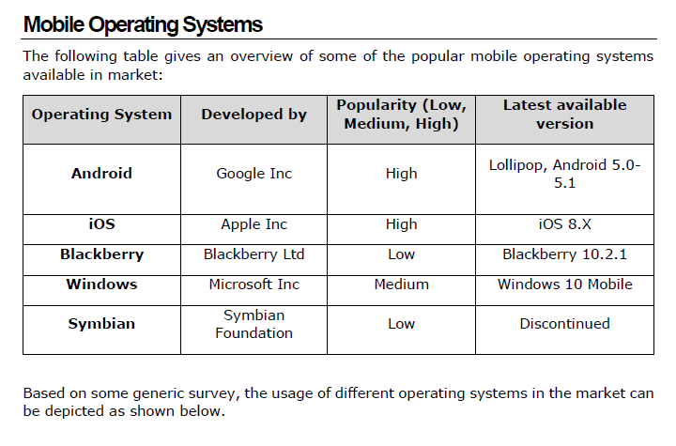
Mobile Testing

Slide 12
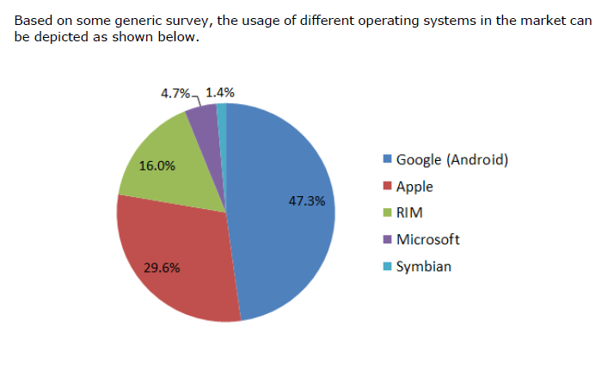
Mobile Popularity

Slide 13
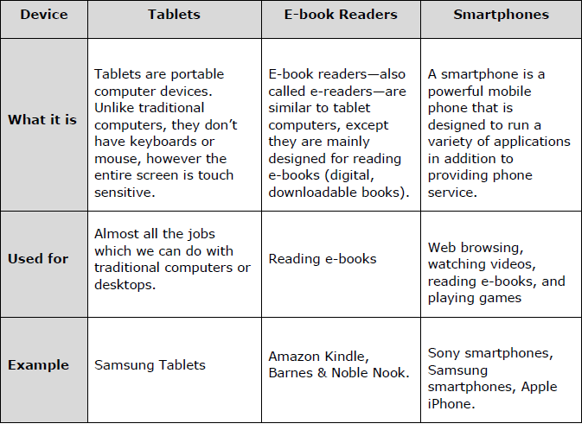
Mobile Device Type

Slide 14

What are the different Application Types?
The Different Application Types:
Native Application
Hybrid Application
MobileWeb Application

Slide 15
Native Application
Native App – Lives on the device.
Pros:
Takes advantage of the device features (use the camera, GPS, etc.)
Uses the device’s notification system
Publishes push notifications
Maintains the same GUI design and offer best experience
Cons:
High cost of building the app
Higher maintenance

Slide 16
Native vs Hybrid vs MobileWeb
Hybrid App – is a way to expose content from existing in App format.
Pros
Cheaper to develop
Easy Maintenance
Takes advantage of the new features available
Embedded browser
Graphics are not accustomed to the O/S
Cons
Slower performance

Slide 17
Native vs Hybrid vs MobileWeb
MobileWeb – are not real applications. They open up in the Mobile Browsers.
Pros
Easy to develop
Easy Update
No Installation required
No Icon on the mobile
Does not take advantage of the Mobile features
Cons
Not on AppStore

Slide 18
Device Testing vs Application Testing
Device Testing
Unit Testing
Factory Testing
Mobile application testing
Hardware testing
Battery (charging) testing
Signal receiving
Network testing
Protocol testing
Mobile games testing
Mobile software compatibility testing
Certification Testing
Application Testing
Functional testing
Laboratory testing
Performance testing
Memory Leakage testing
Interrupt testing
Usability testing
Installation testing
Certification testing
Security testing

Slide 19
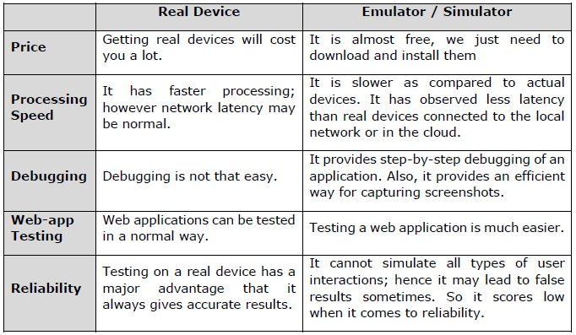
Real Device vs Emulator/Simulator

Slide 20
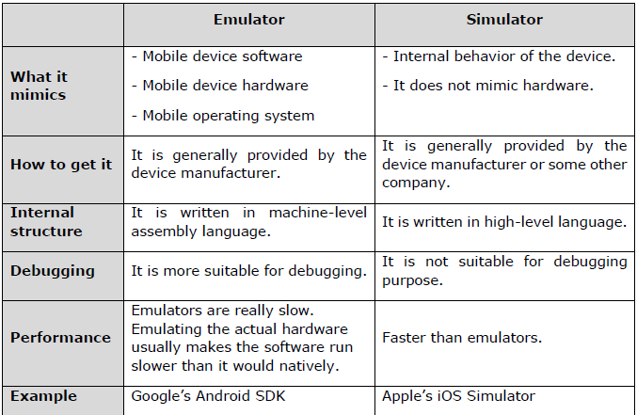
Emulator vs Simulator

Slide 21
iOS and Android Testing Frameworks
The Testing Framework is a code written by QA and it is processed in a special testing environment.
iOS automation testing frameworks allow for:
Defining the format in which to express expectations
Creating a mechanism to hook into or drive the AUT Executing the tests
Reporting results

Slide 22

Android Testing Frameworks
Robotium: is an open-source test framework for developing functional, system and acceptance test scenarios. It is very similar to Selenium.
UIAutomator: is a test framework by Google that provides advance UI testing of native Android apps and games. It has a Java library containing API to create functional UI tests and also an execution engine to run the tests.
Appium: is an open-source test automation framework to test native and hybrid apps and mobile web apps.
Appium library functions inside the framework make calls to the Appium server running in the background which operates the connected device.

Slide 23
Android Testing Frameworks (Continued)
Calabash: is a functional testing framework that can be used for both iOS and Android functional testing.
On paper, it must be one of the easiest frameworks to use and even non-developers should be able to create functional tests using it.
Selendroid: is a relatively new kid on the block and can be used to functionally test your Android applications.
Apparently, if you are used to Selenium, Selendroid should be an easy way to use your knowledge to create your functional tests for Android.

Slide 24
iOS Testing Frameworks
Appium: is an open-source test automation framework to test native and hybrid apps and mobile web apps.
Appium library functions inside the framework make calls to the Appium server running in background which operates the connected device.
Calabash: is a functional testing framework that can be used for both iOS and Android functional testing.
On paper, it must be one of the easiest frameworks to use and even non-developers should be able to create functional tests using it.

Slide 25
iOS Testing Frameworks
Zucchini: is an open-source visual functional testing framework for iOS applications based on Apple UIAutomation.
UI Automation: For your more typical functional tests (or black-box tests), in which you’re going to write code that simulates an end-user navigating your app, there is UI Automation.
UI Automation is provided by Apple and is the Apple-sanctioned way of performing iOS functional testing.
FRANK – for iOS: If you want to do end-to-end testing in iOS and wish you could use Cucumber, no worries — there’s a tool called Frank that will allow you to create acceptance tests and requirements using Cucumber

Slide 26
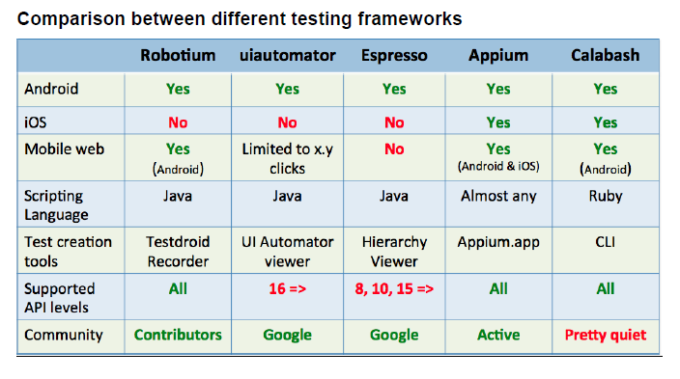
Testing Frameworks

Slide 27
SauceLabs
If all your tests are run on emulators, your app will fail in real-world scenarios.
Real Devices allow you to test more, like GPS, Carrier, etc.
Too many devices?
The best approach is to identify the most-used devices among your user base and test on them.
Maintaining a device lab in-house is expensive, inefficient, and distracts you from the tests you need to run. Instead, renting real mobile devices in the cloud by the minute is a better alternative.
Automate the testing. Performance and load testing is still required.
Sauce Labs provides cloud-based testing for mobile and web applications. It allows running tests for more than 700 different browsers, OS and device combinations.

Slide 28
Mobile Testing references
https://www.tutorialspoint.com/mobile_testing/mobile_testing_tutorial.pdf
https://www.crunchbase.com/organization/sauce-labs

